Slide 1
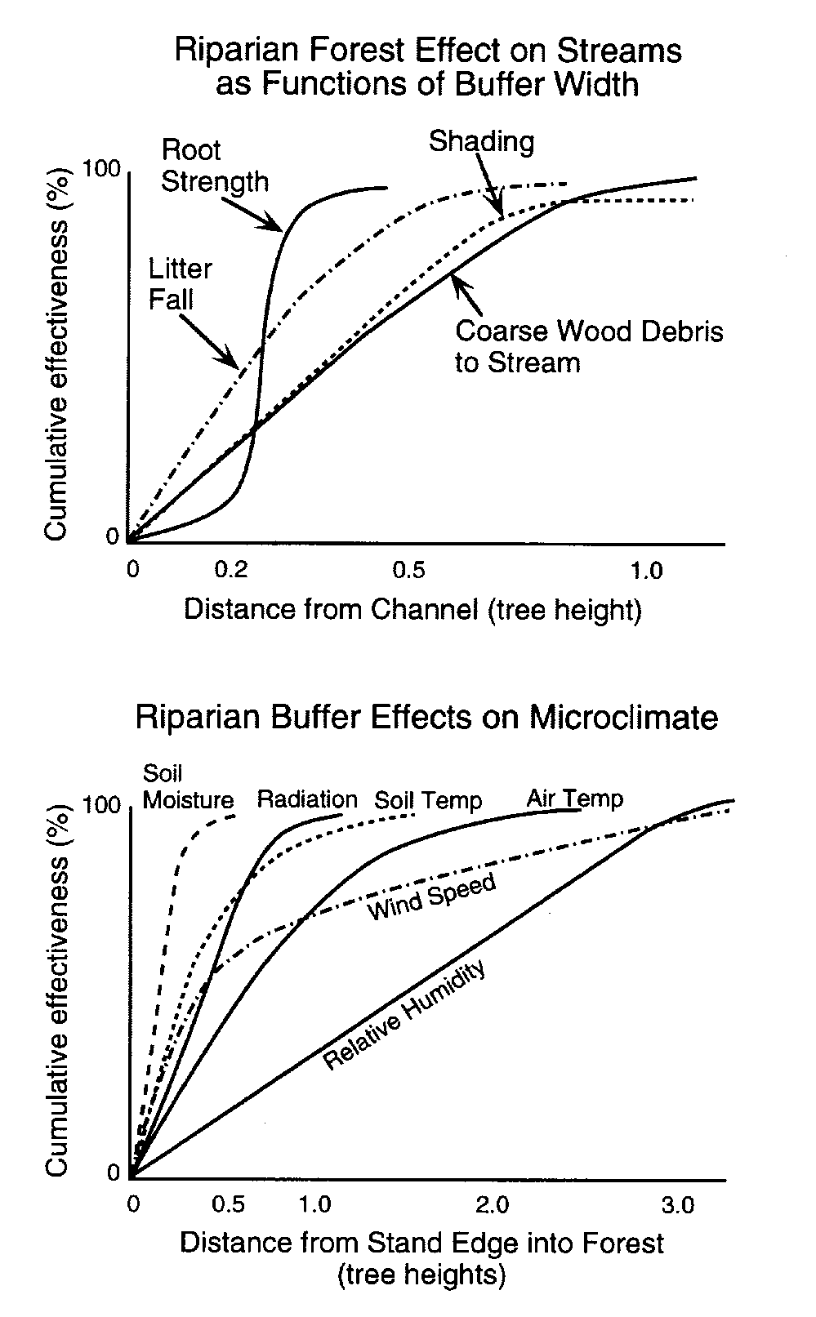
Ecological rationale for determining buffer width
Forest Ecosystem Management and Assessment Team (FEMAT) Report

Slide 2
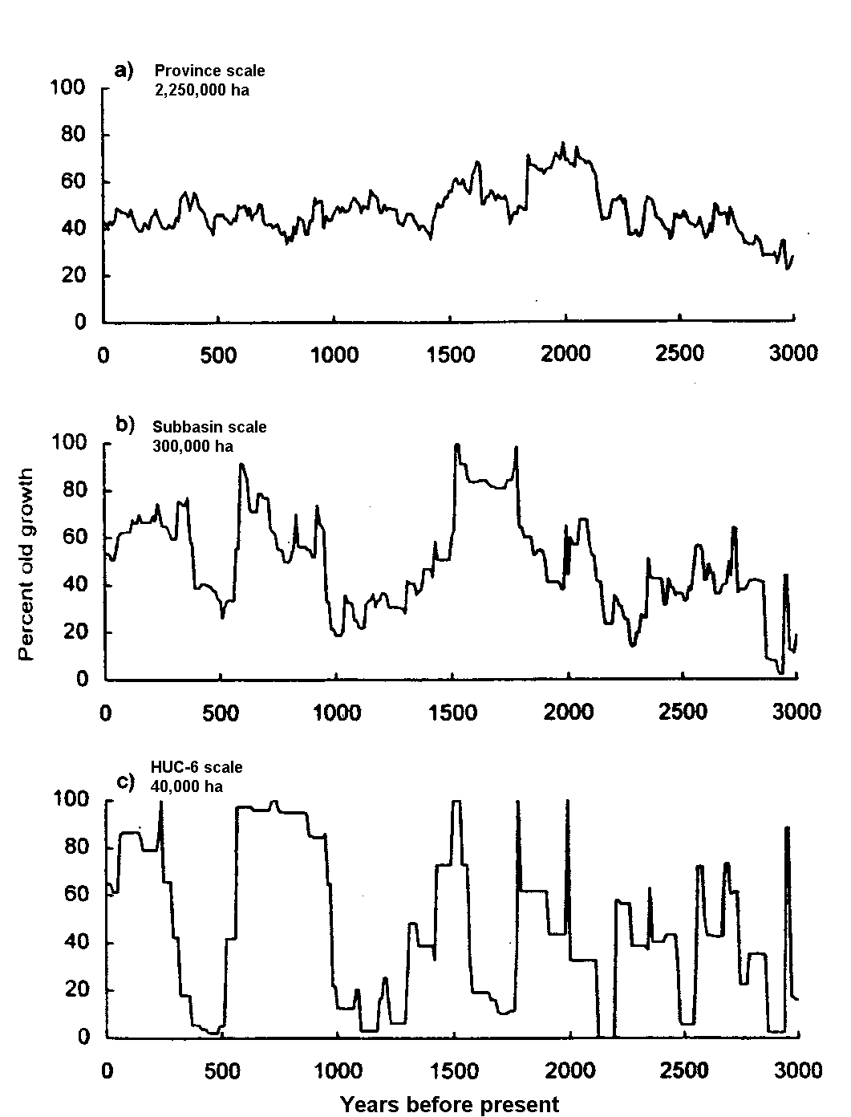
“Long-term changes have not previously been a major consideration when describing the productivity of aquatic ecosystems. Until very recently, streams were often assumed to be relatively stable through time, and likely to recover relatively quickly if they were disturbed by natural events. Unmanaged forests, in contrast, have for some time been understood as very dynamic, with stand ages comprising a series of patches whose location varies over the landscape through time.”
- Reeves and Bisson 2008
Wimberly et al. 2000

Slide 3
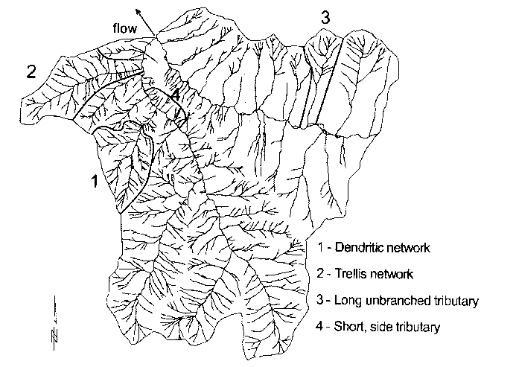
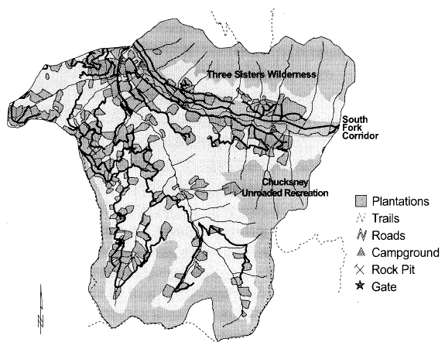
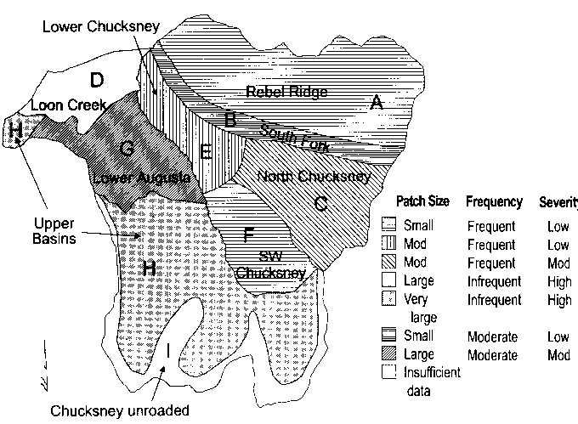
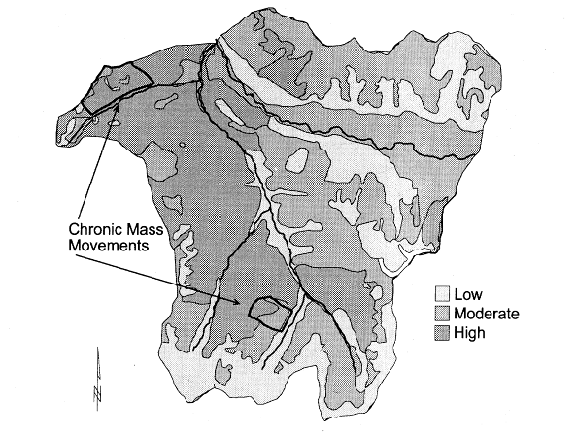
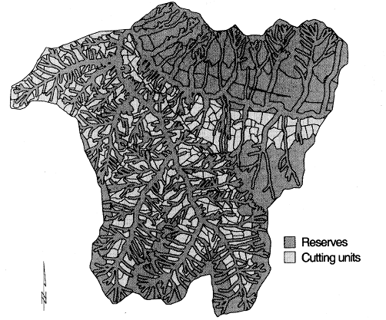
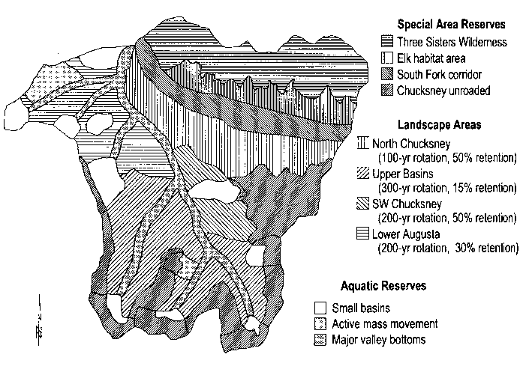
Example of a landscape plan alternative to standard width buffers -- Augusta Creek, OR
Erosion
Fire
Landscape plan
NWFP buffers

Slide 4
Blue River management plan
Cissell et al. 1999

Slide 5
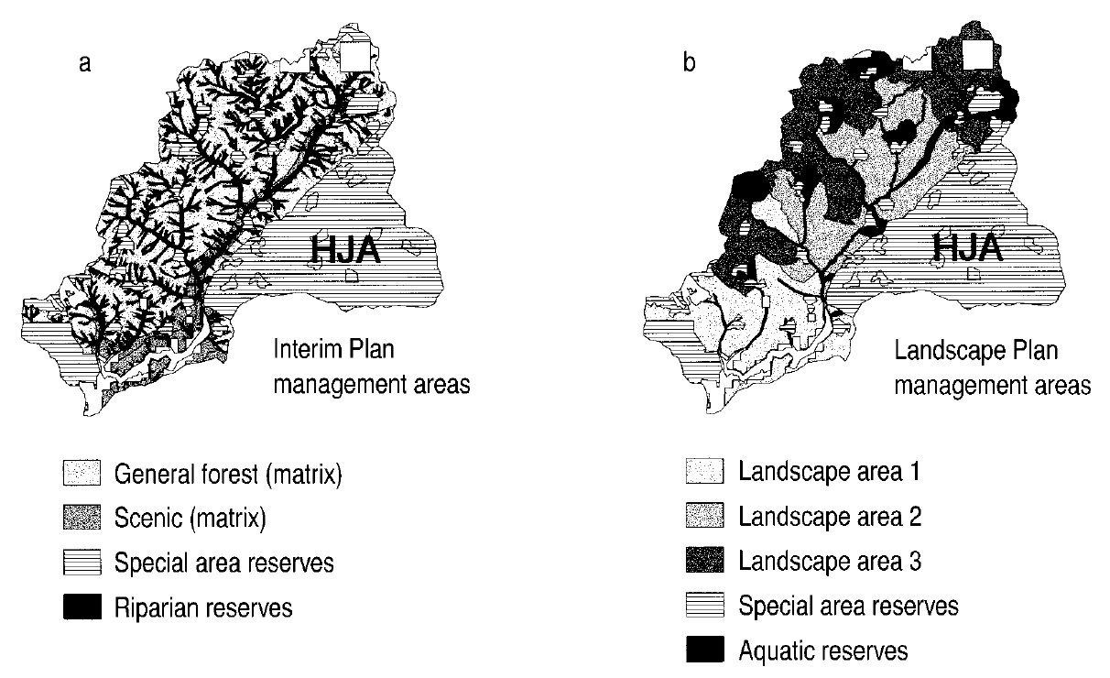
Northwest Forest Plan buffers
Alternative Landscape Plan buffers
Riparian corridor reserves were designated along both sides of all fish-bearing streams (~70–200 m slope distance on each side). These linear reserves occupy the entire valley bottom and adjacent lower hillslopes. Corridor reserves connect aquatic and riparian areas throughout the basin and link with the small watershed reserves. Unlike the Interim Plan, no additional reserves were established at the landscape scale for nonfish-bearing perennial and intermittent streams.
Cissell et al. 1999

Slide 6
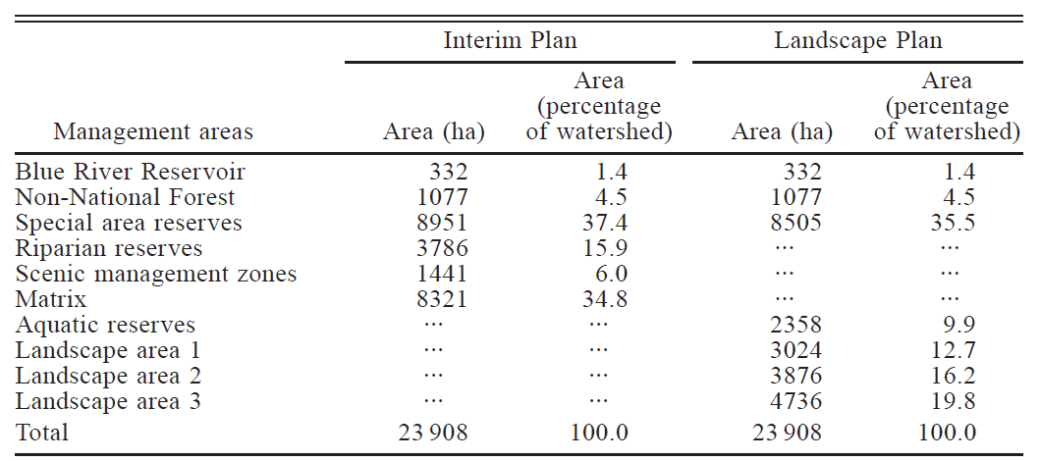
Cissell et al. 1999

Slide 8
Timber production
“The Landscape Plan produces ~17% less wood volume than the Interim Plan in the long term. Differences in manufactured wood volume and wood value are likely less, because the Landscape Plan produces bigger trees due to longer rotation lengths (mean rotation length of 192 yr, compared to the mean rotation length for the Interim Plan of 88 yr).”
Watershed effects
“Significantly larger patch sizes in the Landscape Plan are expected to favor [wildlife] species associated with interior habitats.”
“Riparian and adjacent lower slopes along nonfish-bearing streams would experience some partial cutting under the Landscape Plan. The Landscape Plan provides greater flexibility for management in riparian and adjacent lower slope zones by relying, in part, on lower cutting frequencies through long rotation lengths, as well as lower cutting intensities through greater green-tree retention in the uplands. Some disturbance in these zones is accepted as part of the range of historical conditions. Consequences of these treatments include higher light levels leading to potential localized increases in stream productivity and stream temperature and less than maximum large wood input to streams…Channel stability, stream flow, and sediment inputs are expected to be very similar in the two scenarios.”
“Patches of windthrow in riparian zones are more likely in the sharp-edged landscape of the Interim Plan, but dispersed windthrow may be more common in the Landscape Plan in response to higher densities and greater extent of residual trees in cutting units”
Cissell et al. 1999

