Slide 1

Testing the Ability of Native Cutthroat Trout to Pass Through Small Culverts on Steep Slopes
N. Phil Peterson, Ryan K. Simmons, Jeffery T. Light
Forest & Channel Metrics
Plum Creek Timber Company
Cooperative Monitoring Evaluation and Research Committee
March 22, 2011
Olympia, Washington

Slide 2
Potential impacts of culverts
Alteration of channel processes
Direct loss of habitat
Loss of ecological connectivity
Potential hindrance or barrier to fish passage

Slide 3
Impacted road crossings in the PNW
WASHINGTON
OREGON
BRITISH COLUMBIA
Forest lands: 6,505 barriers in 1997, ~50% have been replaced today (total cost $100M to $200M)
WSDOT: 1,904 (1,470 significant habitat) culvert barriers ($900M)
ODOT: Western OR 733 barriers ($100s M)
76,000 culverts on fish streams, moderate to high risk for passage problems in 58% of cases

Slide 4
Potential culvert-related fish passage issues
Excessive velocities within barrel
Inadequate depths within barrel
Turbulence effects
Excessive drop at culvert outlet
Lack of plunge pool
Accumulation of debris & sediments

Slide 5
Study Objective
Test the ability for wild cutthroat trout to pass through a culvert under a range of flow conditions
Notes:
This is first and foremost an empirical study
The use of wild juvenile fish (non-hatchery) was a key to the study foundation, one of the likely species associated with HW drainages where a lot of the culvert passage issues arise.
Empirical approach needed to understanding how non-uniform flow conditions through culverts directly relates to fish passage
The use of known fish swimming abilities from the literature & our understanding of open-channel flow through culverts is not enough to fully understand the capabilities of fish in the wild faced with a passage challenge

Slide 6
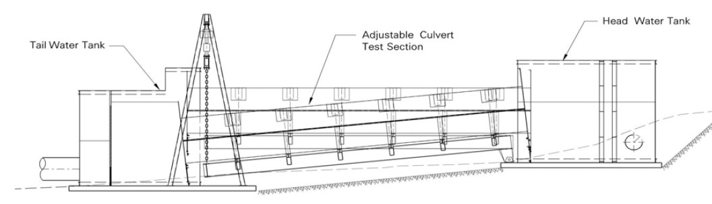
Culvert Test Bed Facility
WDFW Skookumchuck Hatchery
Slope capacity: 0 – 10%
Flow capacity: controllable up to 25 cfs
Adjustable tailwater pool depth
Capacity for testing multiple pipe diameters, shapes and configurations

Slide 7
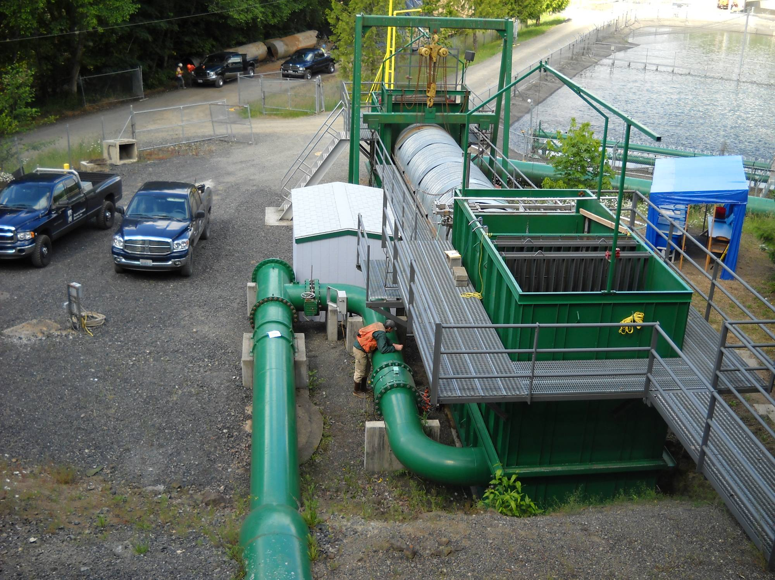

Slide 8
Test Conditions
Targeted average velocities: 2 - 8 fps
Slopes of 0.5 – 8.6%
Discharge: 2 – 14 cfs
All trials using a 6’ ID culvert, 40’ length

Slide 9
Test Conditions

Slide 10
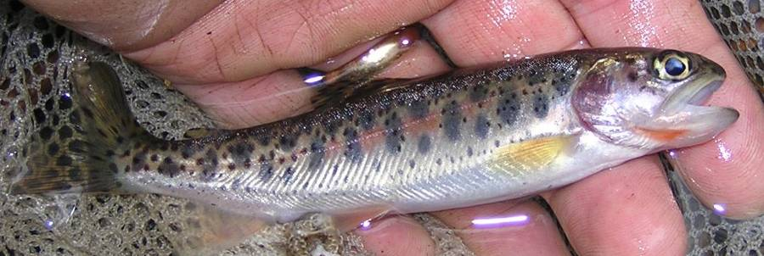
Test Fish Size
(n = 274)

Slide 11
PIT Antenna Array
Pass-through
antenna
Right side pass-under
antenna
Pass-through
antenna
Left side pass-under
antenna
Pass-through
antenna

Slide 12
PIT Antenna Array
Plan View
flow direction
tailwater tank
headwater tank
flow direction

Slide 13
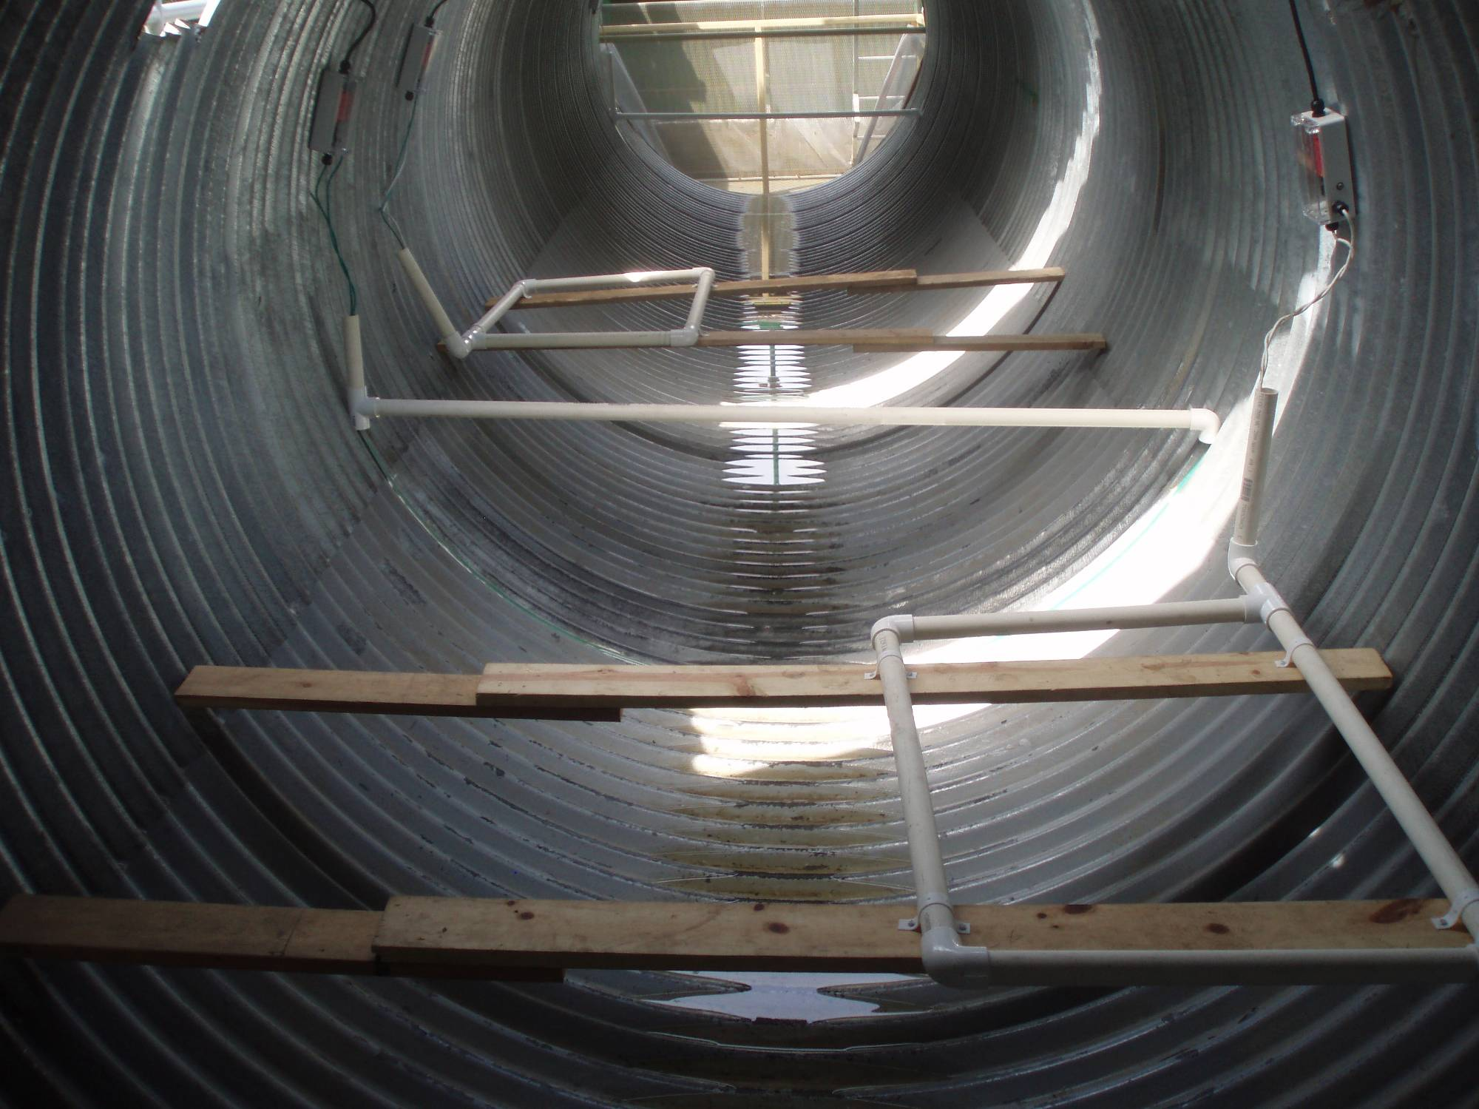
Pass-under PIT Antennas

Slide 14
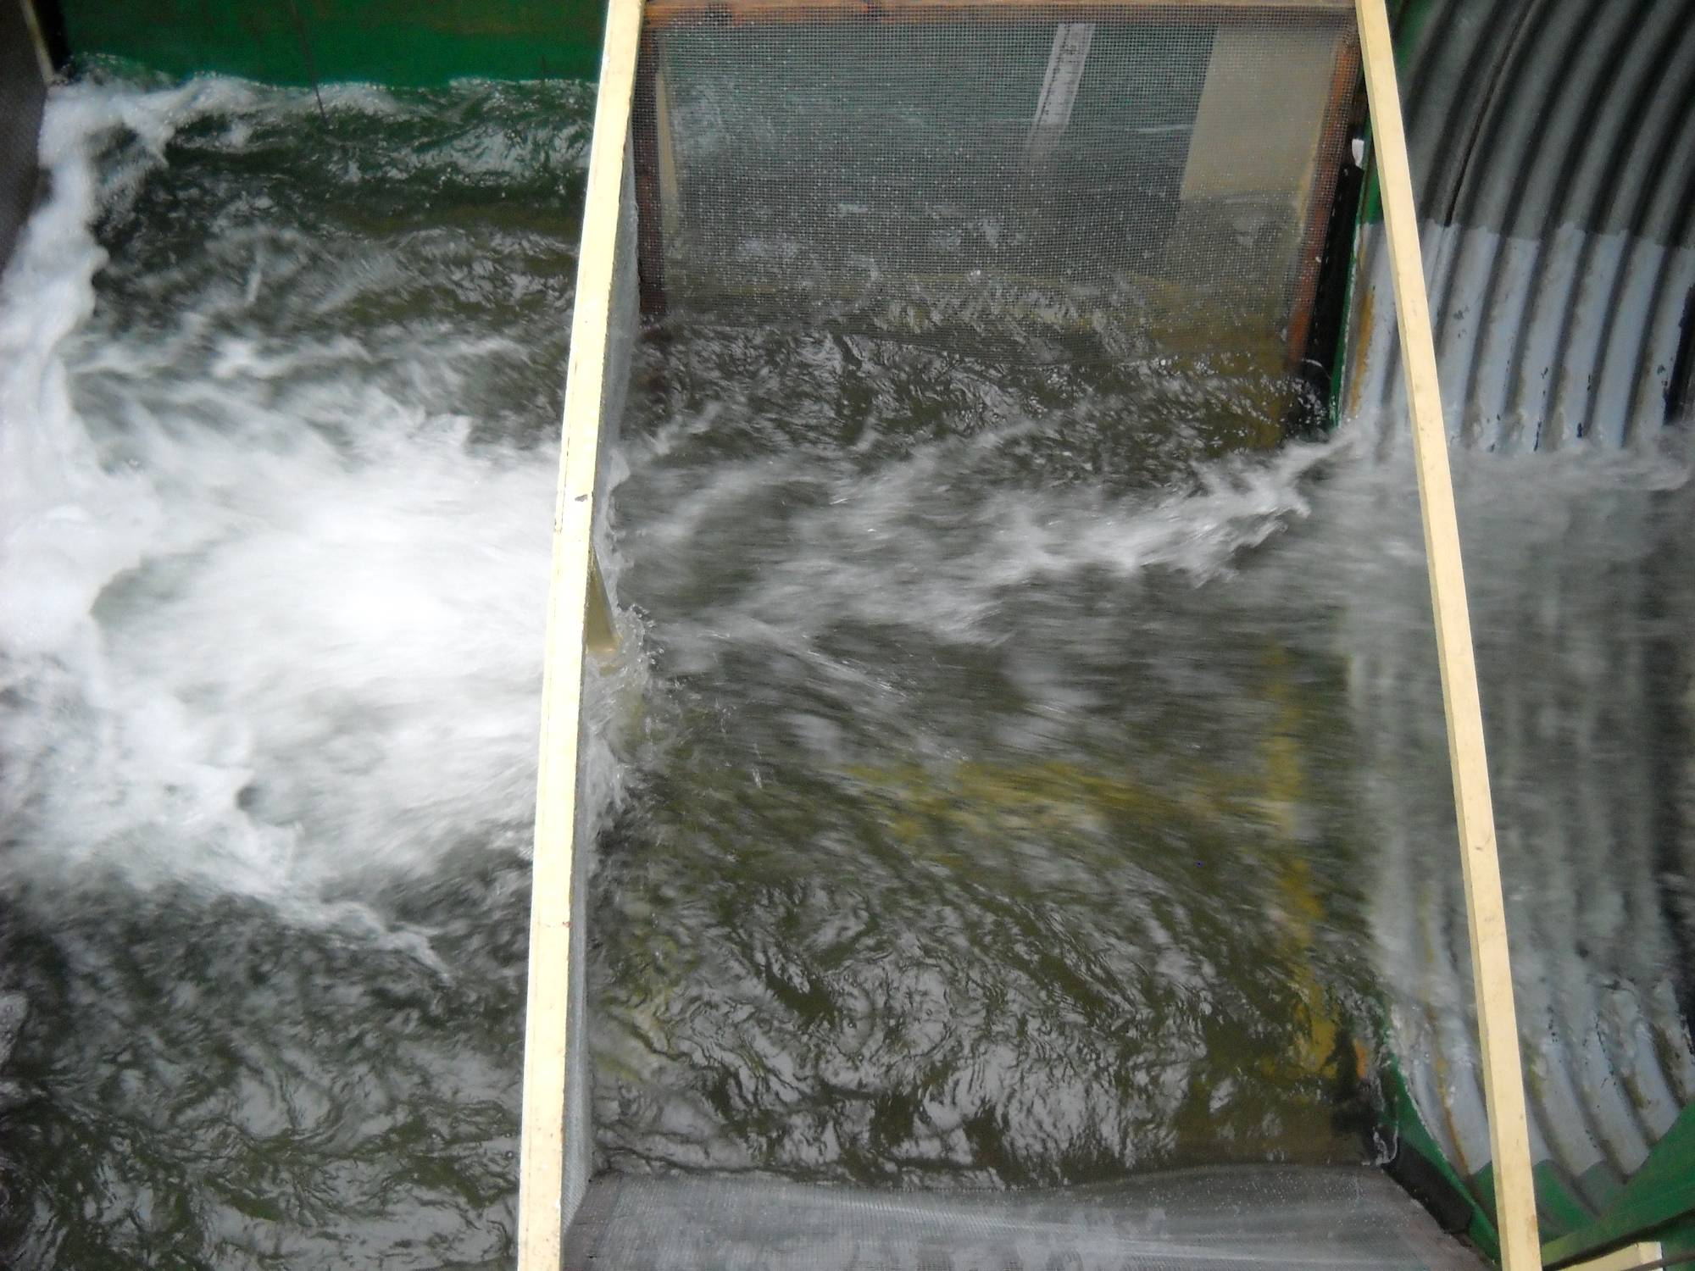
Cross-sectional Hydraulic Asymmetry
higher velocity
lower velocity

Slide 15
Targeted Average Velocities
Average velocity (ft/sec)
Trial (arbitrary)

Slide 16
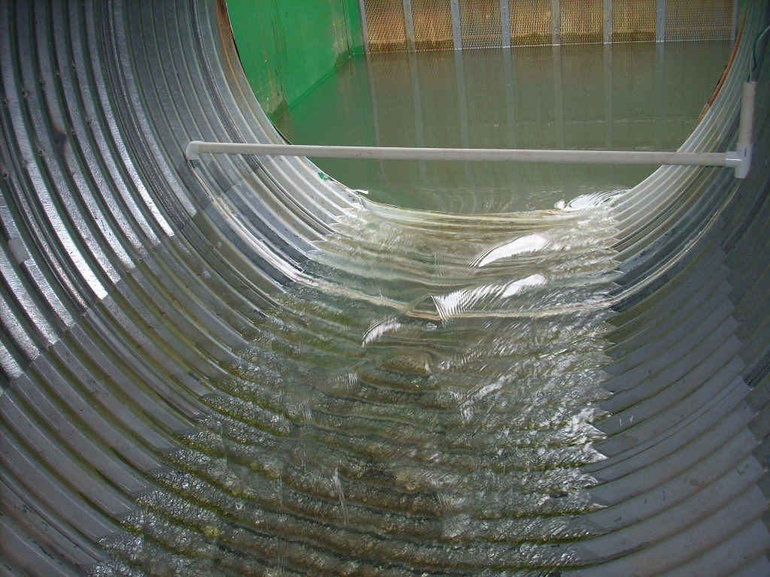
Inlet Conditions
2.0 feet/sec velocity (0.52% slope; 2 cfs discharge)

Slide 17
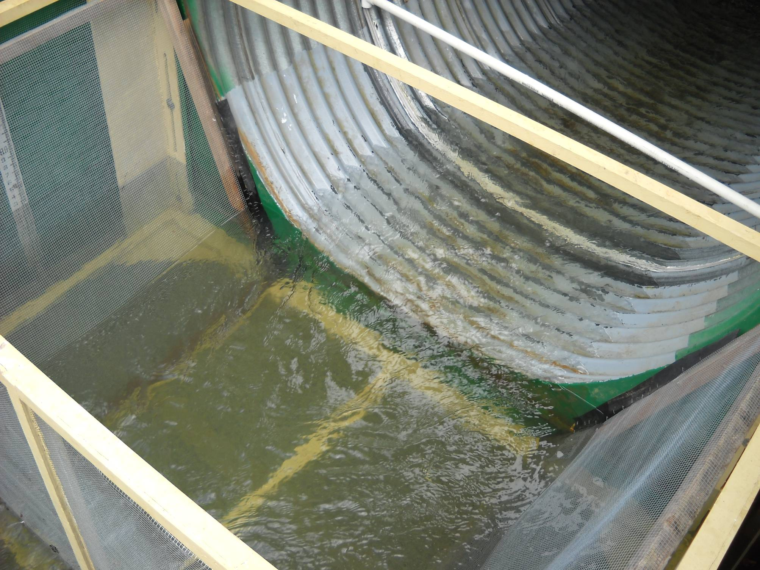
Outlet Conditions
2.0 feet/sec velocity (0.52% slope; 2 cfs discharge)

Slide 18
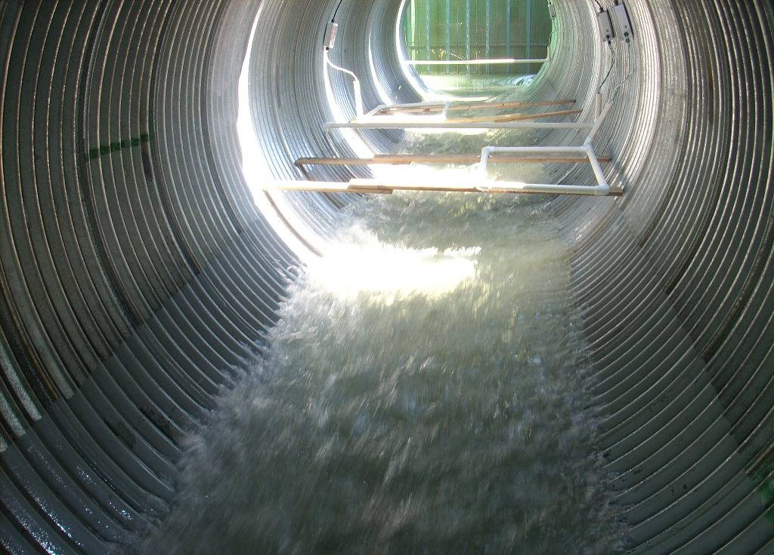
Inlet Conditions
8.0 feet/sec velocity (8.6 % slope; 12 cfs discharge)

Slide 19
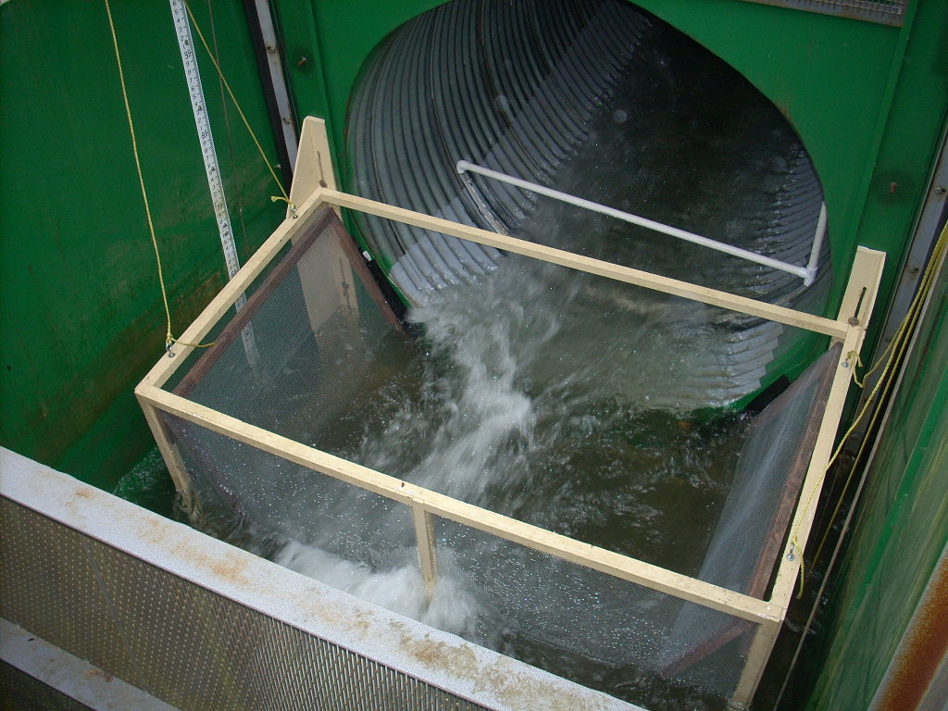
Outlet Conditions
8.0 feet/sec velocity (8.6 % slope; 12 cfs discharge)

Slide 20
Preliminary Results

Slide 21
Participation and Passage
Proportion (%)
Average velocity (ft/sec)

Slide 22
Fish Size & Passage Success
Average velocity (ft/sec)

Slide 24
Summary of results to date
Participation by test fish is high
Fine scale spatial and temporal components to the rates of participation and successful passage captured using the PIT antenna detection system
ONCL are successful in passage conditions beyond that predicted by laboratory swim tests and models
Fish size appears to be more important at the high end of test conditions

Slide 25
Next Steps
Continue test trials by filling in target velocity gaps
Address the need for quantifying hydraulic conditions across the range of trials tested
Target finishing date: Fall 2011

